Slide 1


Modelling and Forecasting Air Quality data with missing values via multivariate time series: Application to Madrid
Authors: Mario Ramírez Jaén, Carolina García Martos & Mª Jesús Sánchez Naranjo
July 2017

Slide 2

Introduction: motivation and data description
Univariate Study
Dynamic Factor Model
Conclusions
Hourly Data
State space Formulation
1
2
3
4
5
6
Introduction Univariate Study DFM Hourly Data State space Conclusions
Notes:
Decir: we will refer from now on to the Dynamic Factor Model as DFM

Slide 3
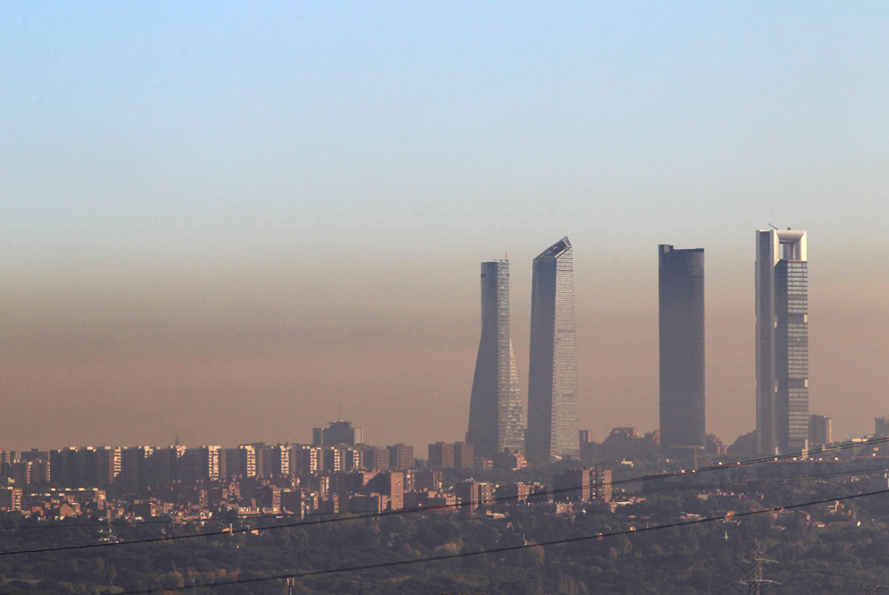
Context
Big cities suffer from Air Quality Issues.
New regulations show up at both national and European scope.
The use of monitorization networks to measure pollution and model as well as forecasting is spreading (Lawson et al. (2011), Febrero-Bande et al. (2007), Castellano et al. (2009)).
Introduction Univariate Study DFM Hourly Data State space Conclusions
Notes:
Real Decreto 102/2011, de 28 de enero, relativo a la calidad del aire.
Plan Nacional de Mejora de la Calidad del Aire (4-Nov-2011)
Directiva 2008/50/CE relativa a la calidad del aire ambiente y a una atmósfera más limpia en europa.
Ley 34/2007, de 15 de noviembre, de Calidad del Aire y Protección de la Atmósfera.

Slide 4
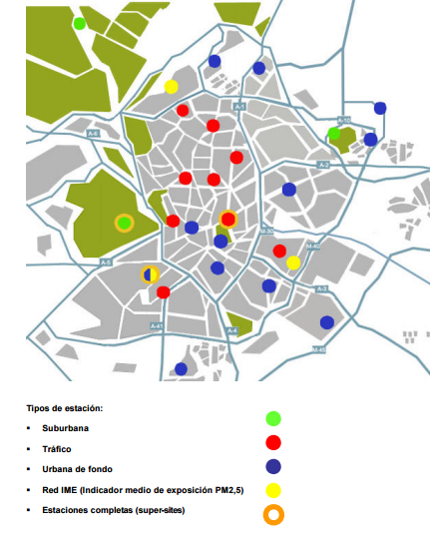
Madrid has a network made of 24 stations. They are the following:
Pza. del Carmen | Barajas
Pza. de España | Méndez Álvaro
Barrio del Pilar | Castellana
Escuelas Aguirre | Retiro Park
Cuatro Caminos | Pza. Castilla
Av. Ramon y Cajal | Ensanche Vallecas
Vallecas | Urb. Embajada
Arturo Soria | Pza. Fdez. Ladrea
Villaverde Alto | Sanchinarro
C/ Farolillo | El Pardo
Moratalaz | Parque Juan Carlos I
Casa de Campo | Tres Olivos
Introduction Univariate Study DFM Hourly Data State space Conclusions

Slide 5
Steps followed along this work-in-progress Project:
Daily data:
Univariate modelling of daily data, for each of the series corresponding to 22 stations in the city of Madrid.
DFM for the 22-dimensional vector of series.
Hourly data:
DFM for the 24 hourly series corresponding to a single station: weekly and yearly seasonality.
DFM for the 24·m series, where m corresponds to the seleted number of stations to be analyzed.
All the aforementioned approaches need intervention of the missing data, and then working with the “corrected series”.
State-space formulation with missing data.

Slide 6
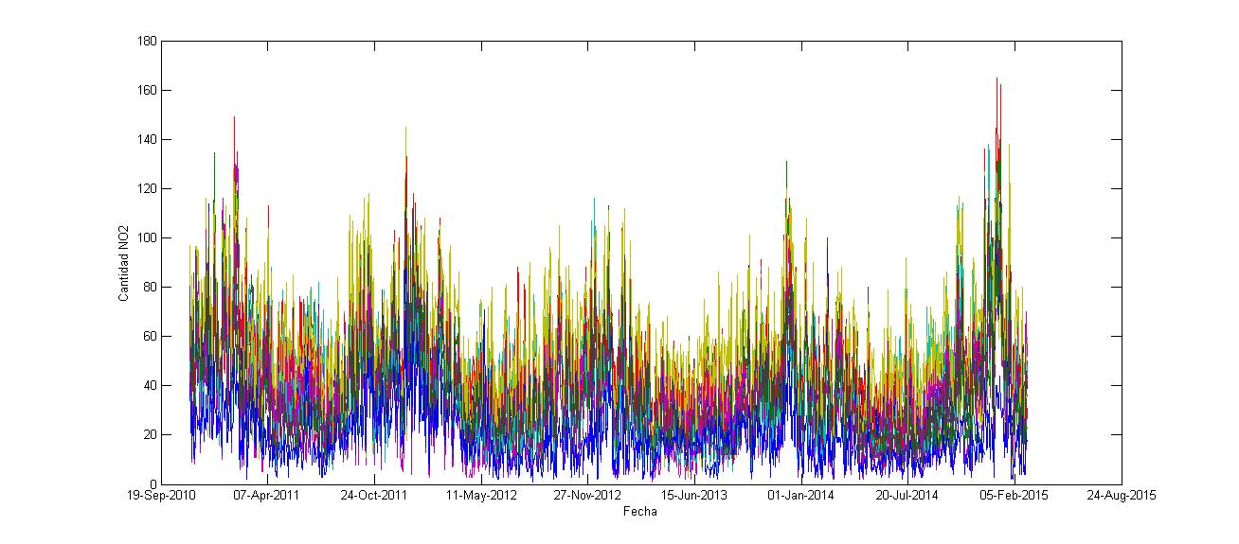
Brief descriptive analysis of the daily data: NO₂, 22 stations
Relationship between these series
Several seasonalities
Introduction Univariate Study DFM Hourly Data State space Conclusions

Slide 7
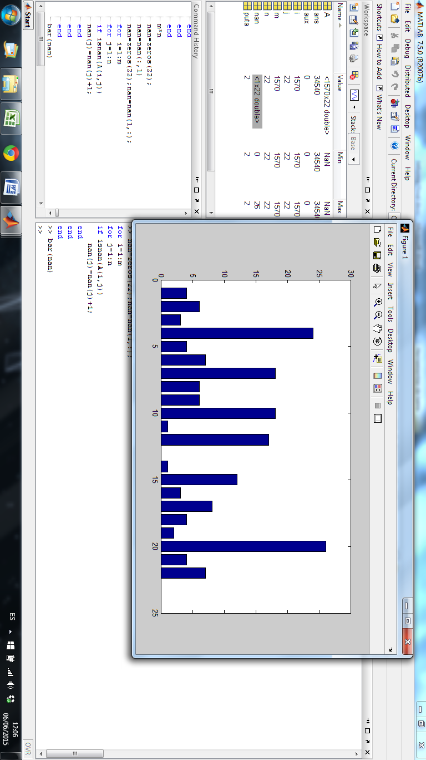
Number of missing data per station
STATION | Missing data
Pza. del Carmen | 4
Pza. de España | 6
Barrio del Pilar | 3
Escuelas Aguirre | 24
Cuatro Caminos | 4
Av. Ramón y Cajal | 7
Vallecas | 18
Arturo Soria | 6
Villaverde Alto | 6
C/ Farolillo | 18
Moratalaz | 1
Casa de Campo | 17
Barajas | 0
Méndez Álvaro | 1
Castellana | 12
Retiro Park | 3
Pza. Castilla | 8
Ensanche Vallecas | 4
Urb. Embajada | 2
Pza. Fdez. Ladrea | 26
Sanchinarro | 4
El Pardo | 7
Introduction Univariate Study DFM Hourly Data State space Conclusions

Slide 8


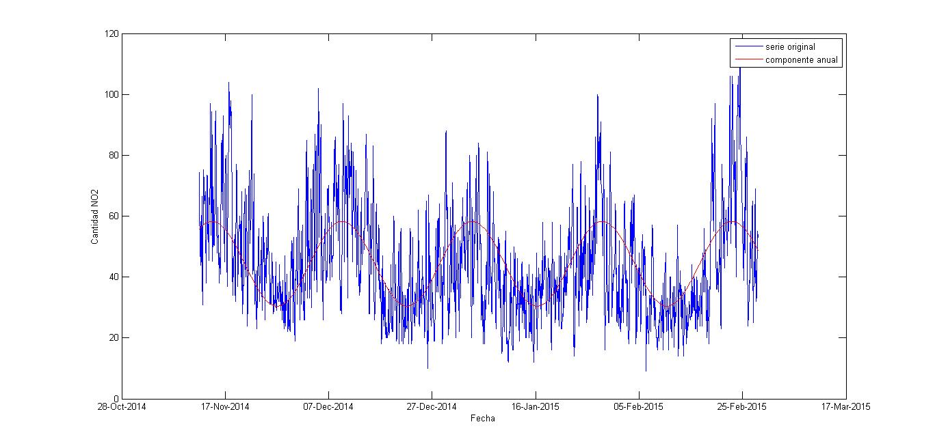
Used Software
Year seasonality treatment
Introduction Univariate Study DFM Hourly Data State space Conclusions

Slide 9
Additional considerations
NO
1. Is leap-year seasonality significant?
2. There are no significant differences between considering missing data in the deterministic treatment of seasonality or doing this before by means of outlier intervention in ARIMA models.
Introduction Univariate Study DFM Hourly Data State space Conclusions

Slide 10
First approach: SARIMA :(p,d,q)x(bp,bd,bq)_{s} models for daily NO₂ concentrations
 | Pza. del Carmen | Pza. de España | Barrio del Pilar | Escuelas Aguirre | Cuatro Caminos | Ramón y Cajal | Vallecas | Arturo Soria | Villaverde Alto | C/ Farolillo | Moratalaz
p | 1 | 1 | 1 | 1 | 1 | 1 | 1 | 1 | 1 | 1 | 1
d | 0 | 0 | 0 | 0 | 0 | 0 | 0 | 0 | 0 | 0 | 0
q | 0 | 0 | 0 | 0 | 0 | 0 | 0 | 0 | 0 | 0 | 0
bp | 0 | 0 | 0 | 0 | 0 | 0 | 0 | 0 | 0 | 0 | 0
bd | 1 | 1 | 1 | 1 | 1 | 1 | 1 | 1 | 1 | 1 | 1
bq | 1 | 1 | 1 | 1 | 1 | 1 | 1 | 1 | 1 | 1 | 1
 | Casa de Campo | Barajas | Mendez Alvaro | Castellana | Retiro | Pza. Castilla | Ensanche Vallecas | Urb. Embajada | Pza. Fdez. Ladrea | Sanchinarro | El Pardo
p | 1 | 1 | 1 | 1 | 1 | 1 | 1 | 1 | 1 | 1 | 1
d | 0 | 1 | 0 | 0 | 0 | 0 | 0 | 0 | 0 | 0 | 1
q | 2 | 1 | 0 | 0 | 2 | 0 | 0 | 0 | 0 | 0 | 1
bp | 0 | 0 | 0 | 0 | 0 | 0 | 0 | 0 | 0 | 0 | 0
bd | 0 | 1 | 1 | 1 | 1 | 1 | 1 | 1 | 1 | 1 | 1
bq | 0 | 1 | 1 | 1 | 1 | 1 | 1 | 1 | 1 | 1 | 1
Introduction Univariate Study DFM Hourly Data State space Conclusions

Slide 11
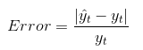
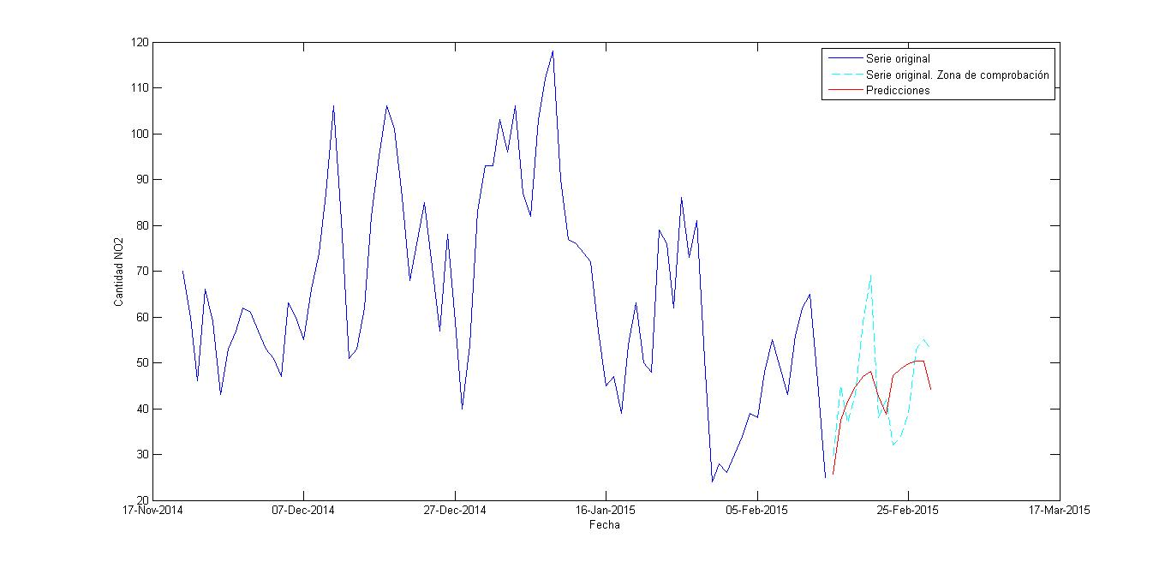
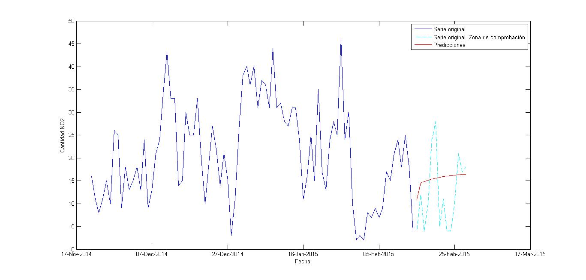
Forecasting Error
1 | 2 | 3 | 4 | 5 | 6 | 7 | 8 | 9 | 10 | 11
12% | 4% | 19% | 3% | 13% | 6% | 7% | 17% | 7% | 34% | 12%
12 | 13 | 14 | 15 | 16 | 17 | 18 | 19 | 20 | 21 | 22
215% | 75% | 5% | 9% | 5% | 17% | 14% | 44% | 23% | 43% | 171%
Introduction Univariate Study DFM Hourly Data State space Conclusions
Notes:
Poner la expresión utilizada para calcular el error de predicción

Slide 12
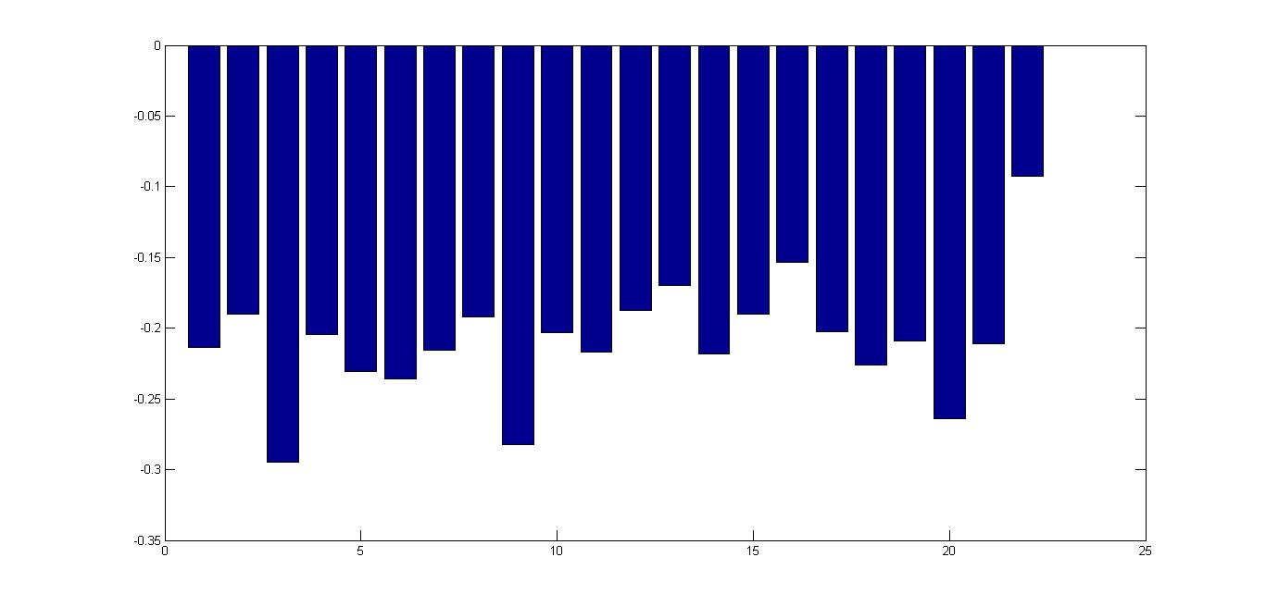
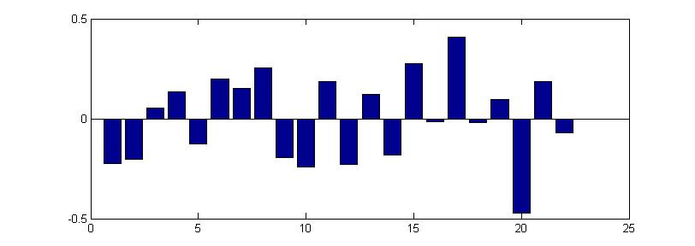
Used Software
“An amount of unobserved common factors (r), clearly smaller than the amount of series (r<<m), can explain the series variability”.
1 | 2 | 3 | 4 | 5 | 6 | 7 | 8 | 9 | 10 | 11
84,7% | 4,1% | 1,7% | 1,6% | 1,0% | 0,9% | 0,8% | 0,7% | 0,6% | 0,5% | 0,4%
12 | 13 | 14 | 15 | 16 | 17 | 18 | 19 | 20 | 21 | 22
0,4% | 0,4% | 0,3% | 0,3% | 0,3% | 0,3% | 0,2% | 0,2% | 0,2% | 0,1% | 0,1%
1st common factor
2nd common factor
Station
Station
Introduction Univariate Study DFM Hourly Data State space Conclusions

Slide 13
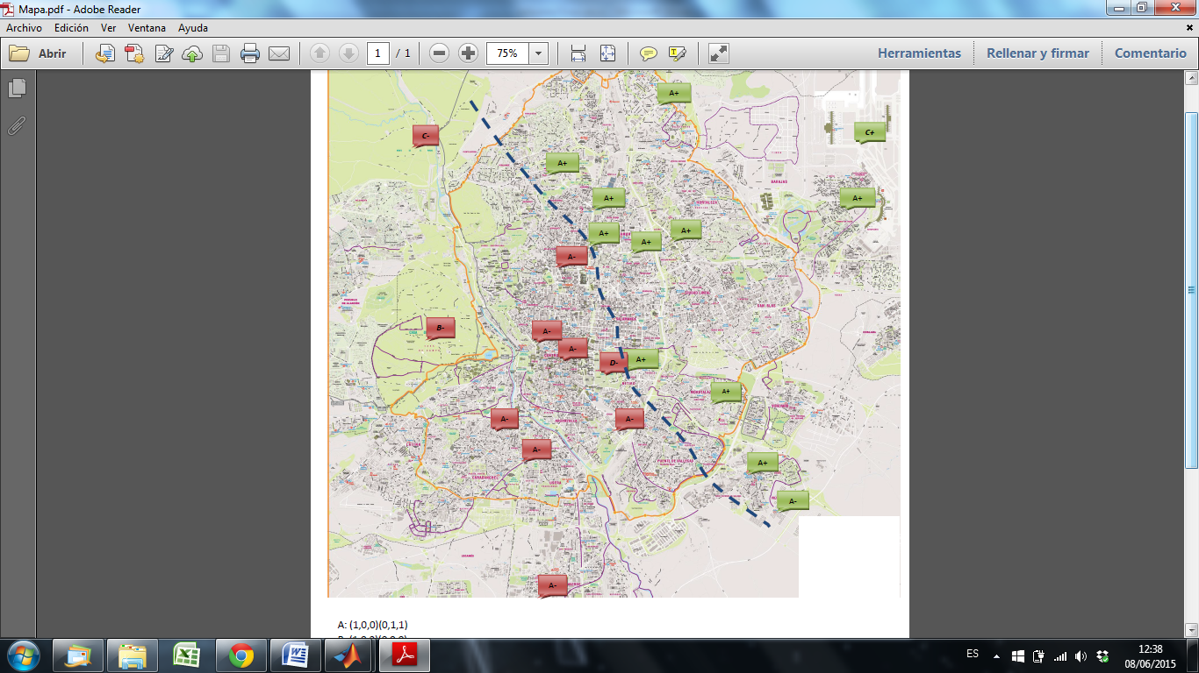
Geographical interpretation of the 2nd common factor
Introduction Univariate Study DFM Hourly Data State space Conclusions

Slide 14
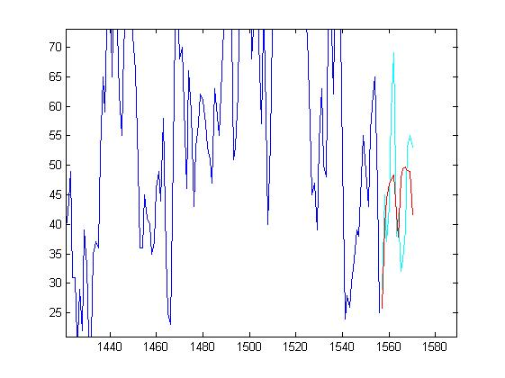
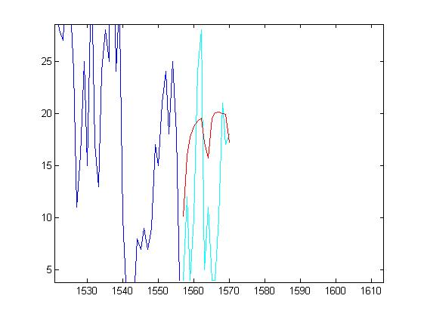
Forecasting Error
1 | 2 | 3 | 4 | 5 | 6 | 7 | 8 | 9 | 10 | 11
18% | 21% | 36% | 21% | 40% | 18% | 27% | 26% | 31% | 46% | 23%
12 | 13 | 14 | 15 | 16 | 17 | 18 | 19 | 20 | 21 | 22
92% | 26% | 37% | 27% | 26% | 21% | 37% | 26% | 38% | 21% | 75%
Introduction Univariate Study DFM Hourly Data State space Conclusions

Slide 15
¿Why?
Regulations establishes hourly pollution limits.
Challenges
Course of dimensionalty
Double Seasonality
Approaches
Parallel approach station by station
Parallel approach for all series
Solutions
Select just two stations
SCA (software)
Introduction Univariate Study DFM Hourly Data State space Conclusions

Slide 16
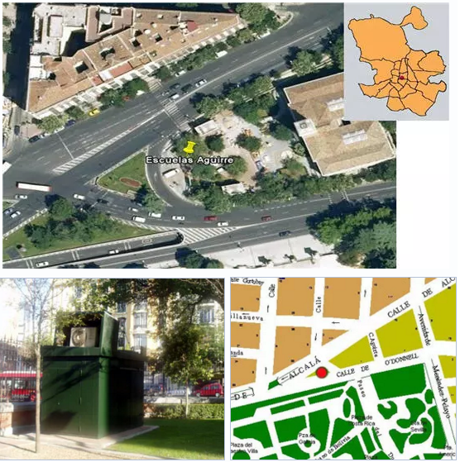
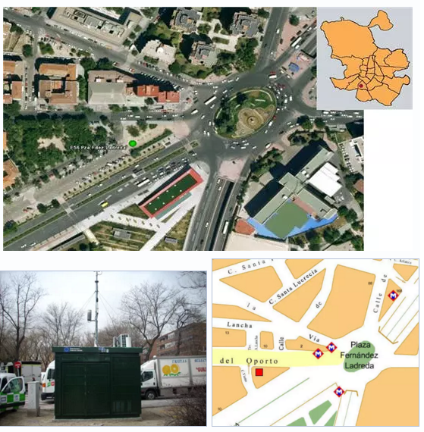
Escuelas Aguirre
Fernández Ladreda
Introduction Univariate Study DFM Hourly Data State space Conclusions

Slide 17

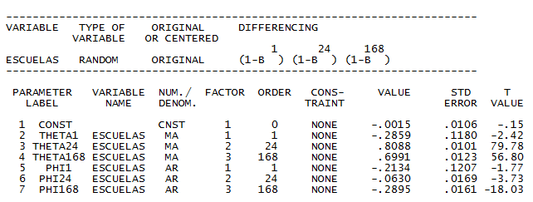
Used Software
Parallel Approach Station by Station
¡Double Seasonality!
ARIMA (1,1,1)x(1,1,1)₂₄x(1,1,1)₁₆₈
Introduction Univariate Study DFM Hourly Data State space Conclusions

Slide 18
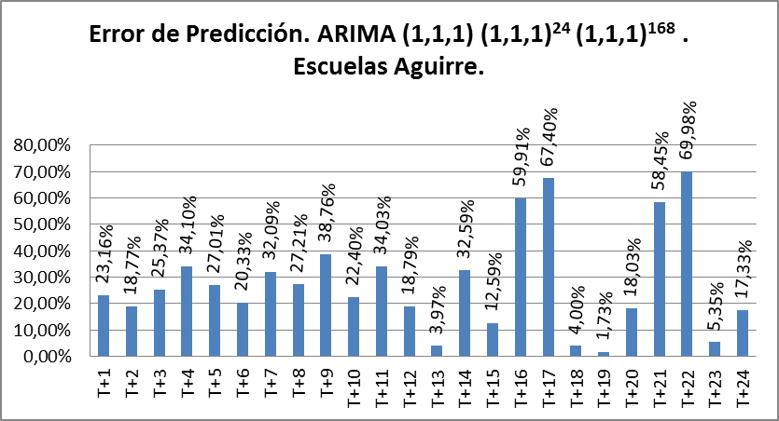
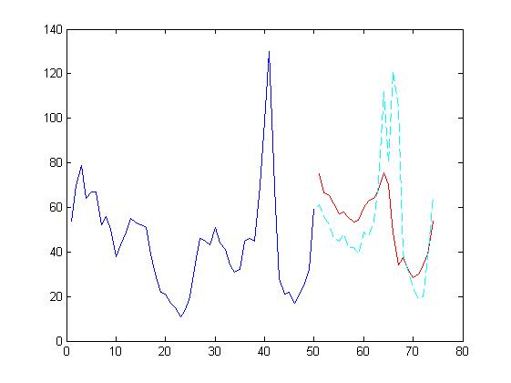
Forecasting Error.
Forecasts become inaccurate after 12 hours, h>12.
Forecasting error around 20% for the first 12 hours (forecasting horizon h=1,…,12).
Pollution
Time
Introduction Univariate Study DFM Hourly Data State space Conclusions

Slide 19
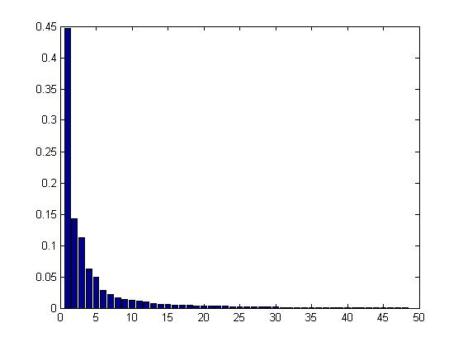
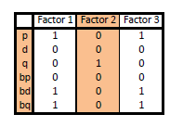
Used Software
Parallel Approach All Stations
Dynamic Factor Model (DFM)
Variability explained by the common factors
3 Factors
EV
Factor
Introduction Univariate Study DFM Hourly Data State space Conclusions

Slide 20
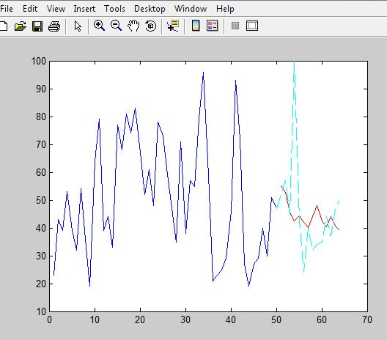
Average forecasting error around 40%.
Great amount of outliers
Example: Window 505, hour 1, Escuelas Aguirre
Horizon | 1 | 2 | 3 | 4 | 5
Error | 5,92% | 7,3% | 1,19% | 57,42% | 3%
Contaminación
(Sep-Oct 2013)
Time
Introduction Univariate Study DFM Hourly Data State space Conclusions

Slide 21
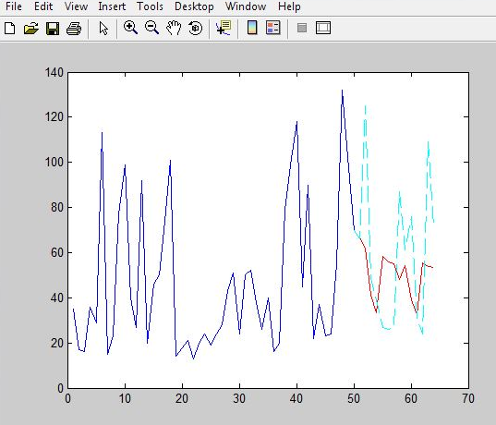
Average forecasting error around 40%
Great amount of outliers
Example: Window 400, hour 1, Escuelas Aguirre
Horizon | 1 | 2 | 3 | 4
Error | 0,87% | 50,36% | 15,7% | 14,32%
Contaminación
Time
Introduction Univariate Study DFM Hourly Data State space Conclusions

Slide 22
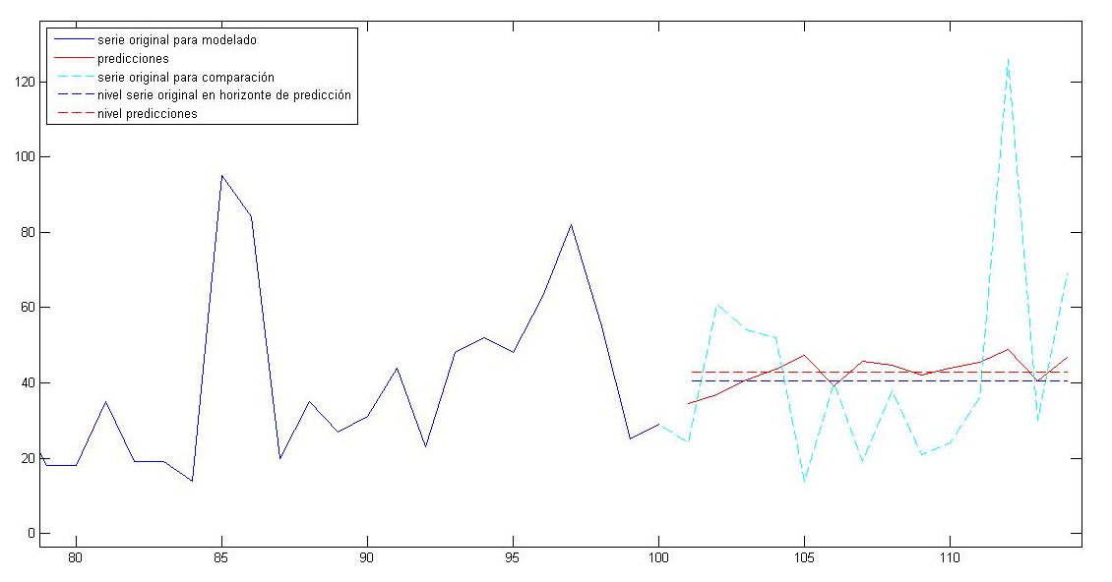
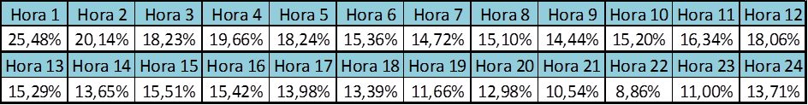
Forecasting Error
when trying to forecast the level of the series
Pollution
Time
Introduction Univariate Study DFM Hourly Data State space Conclusions

Slide 23

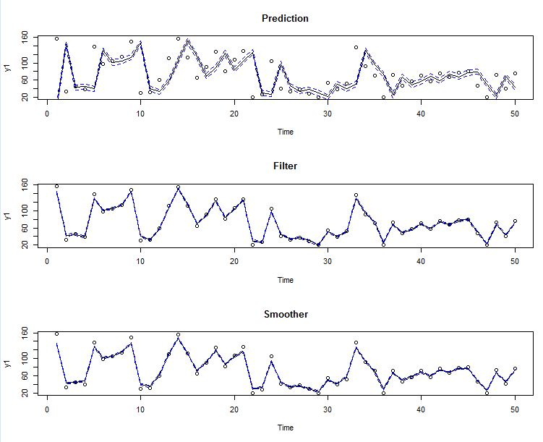
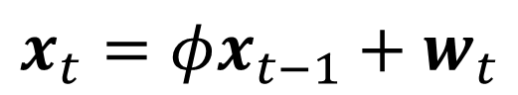

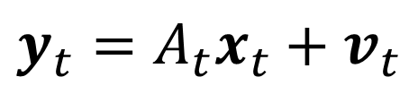
State Equation
$$x_{t}=φx_{t−1}+w_{t}$$
Used Software
Observation Equation
$$y_{t}=A_{t}x_{t}+v_{t}$$
Aim: Estimate the value of $x_{t}$ from the observations $Y_{s}=\{y_{1},…,y_{s}\}$
s>t
Smooth
s<t
Forecasting
s=t
Filter
Introduction Univariate Study DFM Hourly Data State space Conclusions

Slide 24
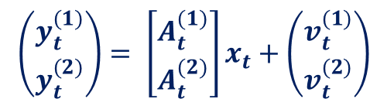
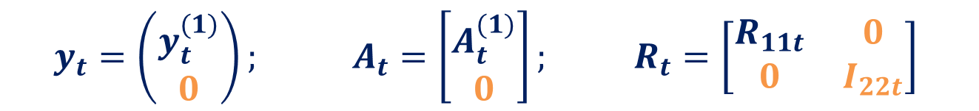

Ejemplo con 24 series
SS with Missing Data
Missing data do not modify the problems dimension
$$\left(\begin{matrix}y_{t}^{(1)} \\ y_{t}^{(2)}\end{matrix}\right)= \left[\begin{matrix}A_{t}^{(1)} \\ A_{t}^{(2)}\end{matrix}\right]x_{t}+\left(\begin{matrix}v_{t}^{(1)} \\ v_{t}^{(2)}\end{matrix}\right)$$
Being $y_{t}^{\left(2\right)}$ missing data
$$y_{t}=\left(\begin{matrix}y_{t}^{(1)} \\ 0\end{matrix}\right); A_{t}=\left[\begin{matrix}A_{t}^{(1)} \\ 0\end{matrix}\right]; R_{t}=\left[\begin{matrix}R_{11t} & 0 \\ 0 & I_{22t}\end{matrix}\right]$$
Introduction Univariate Study DFM Hourly Data State space Conclusions

Slide 25
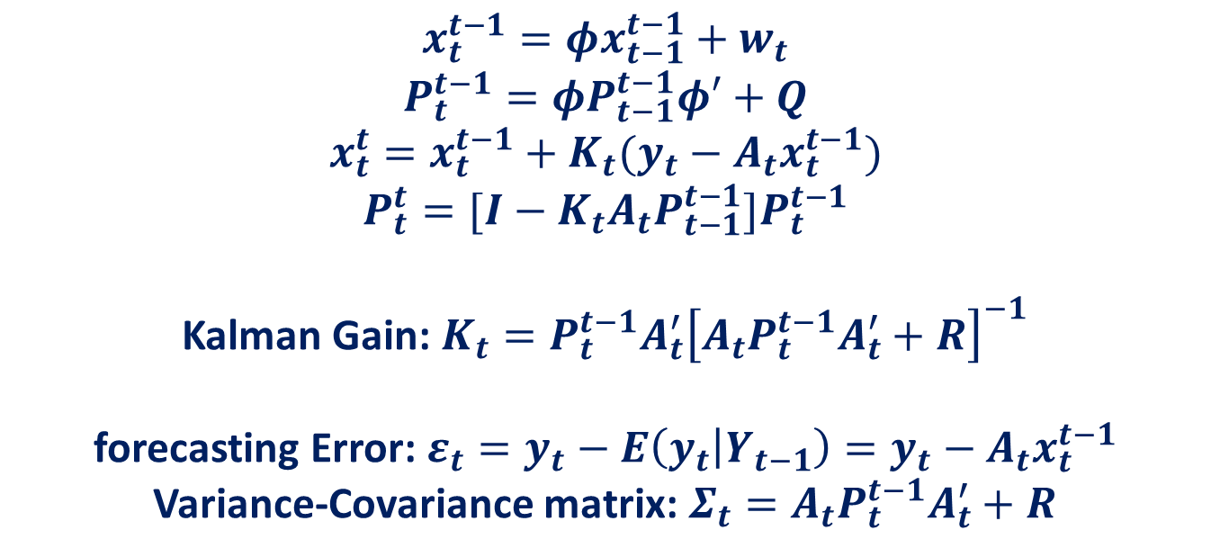
Kalman Filter
$$x_{t}^{t−1}=φx_{t−1}^{t−1}+w_{t}$$
$$P_{t}^{t−1}=φP_{t−1}^{t−1}φ′+Q$$
$$x_{t}^{t}=x_{t}^{t−1}+K_{t}(y_{t}−A_{t}x_{t}^{t−1})$$
$$P_{t}^{t}=[I−K_{t}{A_{t}P}_{t−1}^{t−1}]P_{t}^{t−1}$$
Kalman Gain: $K_{t}=P_{t}^{t−1}A_{t}^{′}{\left[A_{t}P_{t}^{t−1}A_{t}^{′}+R\right]}^{−1}$
forecasting Error:$ε_{t}=y_{t}−E\left(y_{t} | Y_{t−1}\right)=y_{t}−A_{t}x_{t}^{t−1}$
Variance-Covariance matrix: $Σ_{t}=A_{t}P_{t}^{t−1}A_{t}^{′}+R$
Introduction Univariate Study DFM Hourly Data State space Conclusions

Slide 26

Maximum likelihood estimation
$$Likelihood ≡ L_{Y}\left(Θ\right)$$
$$−ln L_{Y}\left(Θ\right)=\frac{1}{2}\sum_{t=1}^{n}{log} \left|Σ_{t}\left(Θ\right)\right|+\frac{1}{2}\sum_{t=1}^{n}{ε_{t}\left(Θ\right)′} {Σ_{t}\left(Θ\right)}^{−1}ε_{t}\left(Θ\right)$$
Ѳ⁽⁰⁾
ε_{t}⁽⁰⁾ y Σ_{t}⁽⁰⁾
N-R
Ѳ⁽¹⁾
…
Ѳ^{(j)}
Newton-Raphson iterative process
Introduction Univariate Study DFM Hourly Data State space Conclusions

Slide 27
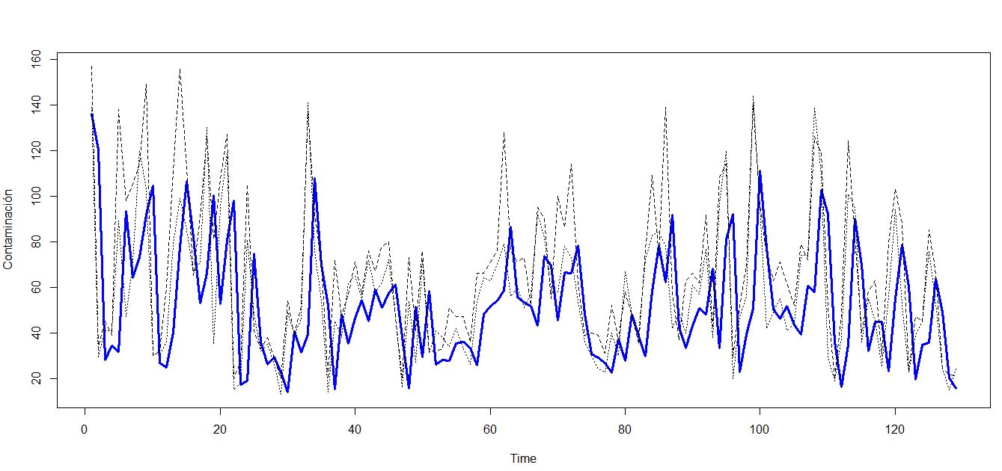
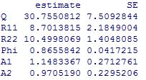
Example with two series
Escuelas Aguirre, hour 1 & hour 2
Estimated parameters:
~1 Similar to Bivariate Local Level Model
Introduction Univariate Study DFM Hourly Data State space Conclusions

Slide 28
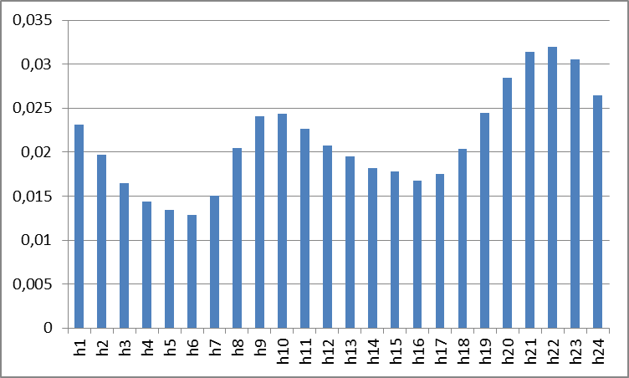
Example with 24 series
Φ ~1 Similar to a Multivariate Local Level
A_{i} ~ 0,21=1/48
Pesos de la matriz de estado A
Introduction Univariate Study DFM Hourly Data State space Conclusions

Slide 29
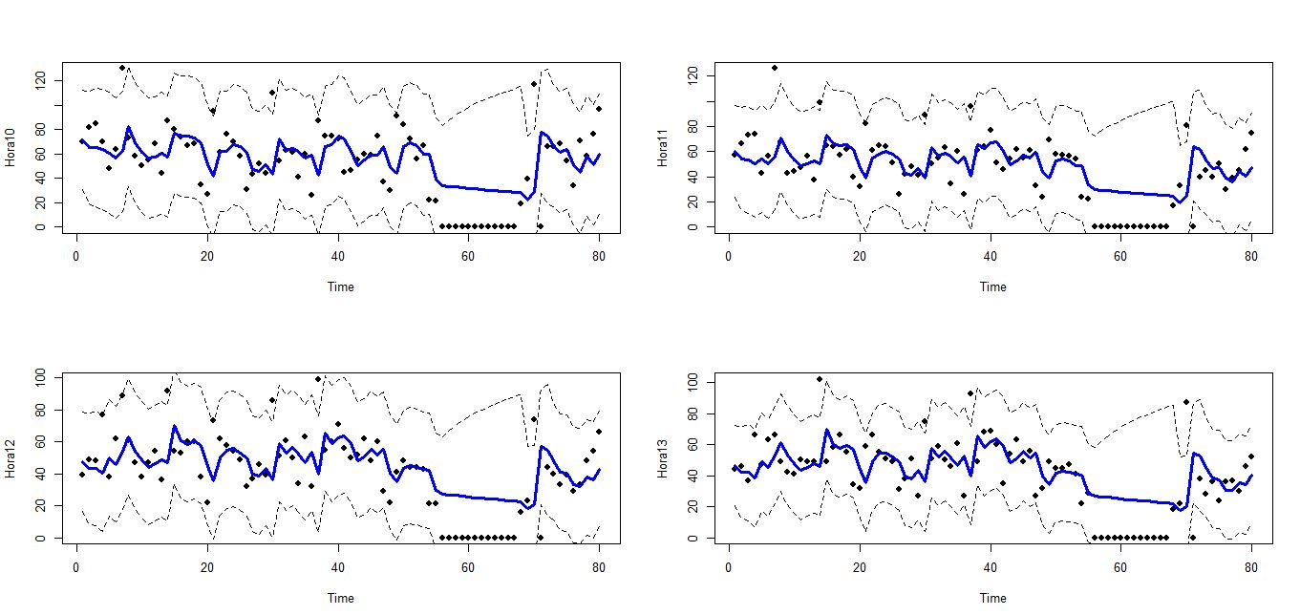
SS with Missing Data
Example with consecutive missing data:
Hour 10
Hour 11
Hour 12
Hour 13
Flat shape, far from reality
Introduction Univariate Study DFM Hourly Data State space Conclusions

Slide 30
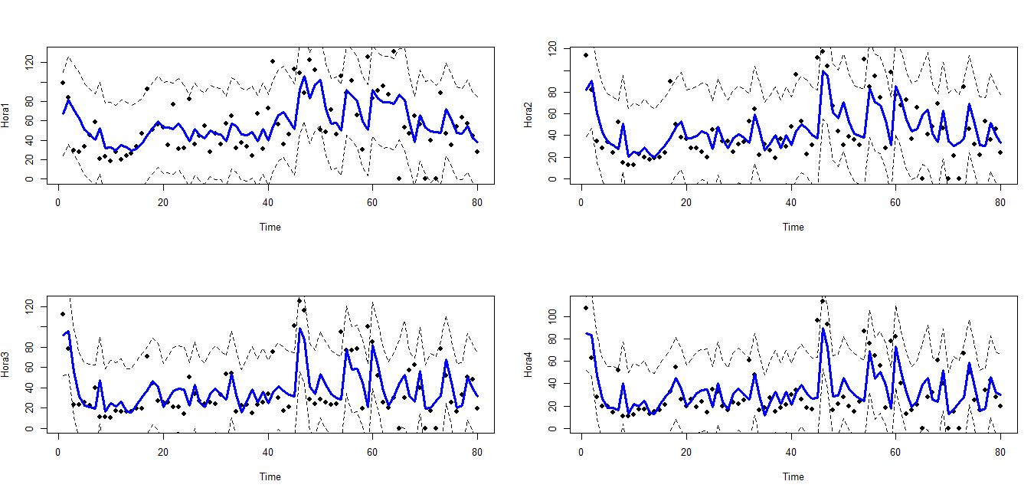
SS with Missing Data
Example with isolated missing data:
Hour 1
Hour 2
Hour 3
Hour 4
Good fit to the real series
Introduction Univariate Study DFM Hourly Data State space Conclusions

Slide 31
Daily data conclusions:
There is a dominant model for daily data series: ARIMA (1,0,0)×(0,1,1)
A geographic dependence, with two clearly differentiated areas, has been identified
El Pardo & La Casa de Campo can’t be forecasted with an hourly data model
Introduction Univariate Study DFM Hourly Data State space Conclusions

Slide 32
Hourly data conclusions:
With an ARIMA (1,1,1) × (1,1,1)24 × (1,1,1)168 20% forecasting error can be achieved for no disaggregated data.
Hourly data are more unstable and have more outliners tan daily date, making them more difficult to forecast.
With disaggregated date model can only make level forecasting
Introduction Univariate Study DFM Hourly Data State space Conclusions

Slide 33
State space conclusions:
The best value for the transition matrix in close to 1, being that the value used in a Local Level model.
For a big number of series n, observation matrix components have a value around 1/n.
With few series, observation matrix components are close of those of a Local Level.
Introduction Univariate Study DFM Hourly Data State space Conclusions

Slide 34
j
Further Research
3D Spatio-temporal modelling
Consider more general models than just a MLL
Study relationship between pollutants
and Extend the State Space formulation for the data
Forecasting with SS models
Introduction Univariate Study DFM Hourly Data State space Conclusions

Slide 35

THANK YOU FOR YOUR ATTENTION

Slide 36


